Slide 1
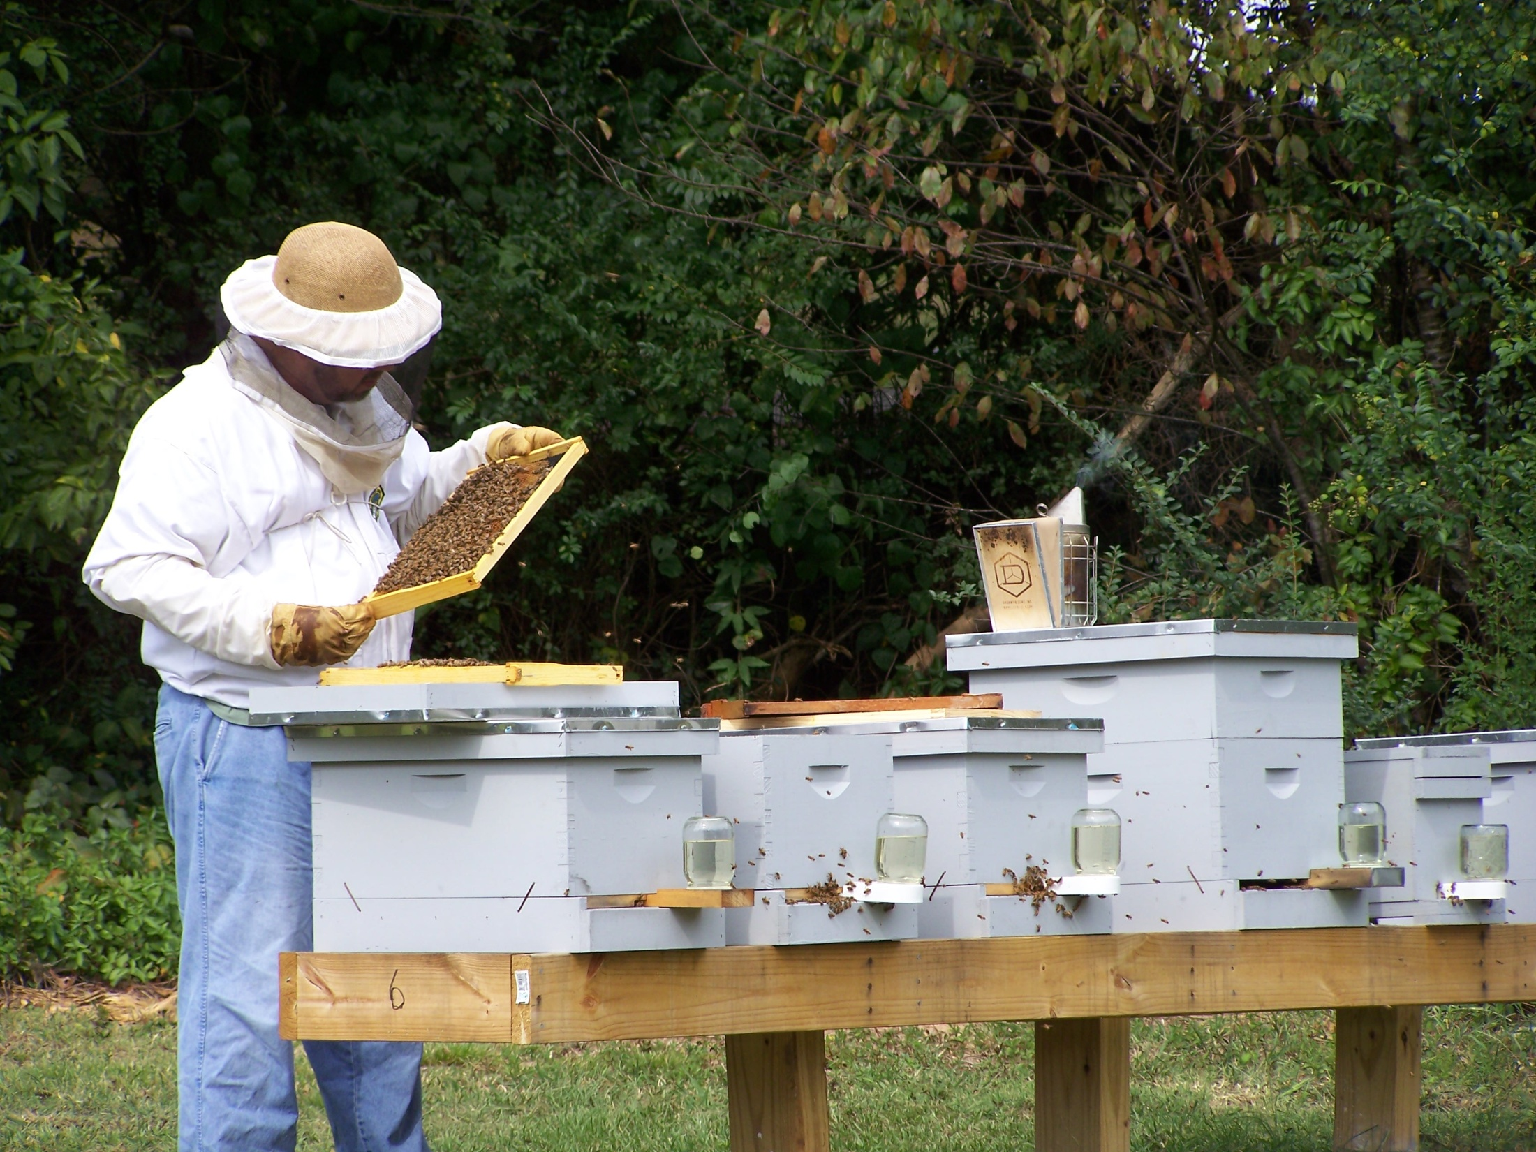
Year Round Beekeeping & Managing Colonies Presented by Ray Civitts Mountain Sweet Honey Company Toccoa, GA

Slide 2
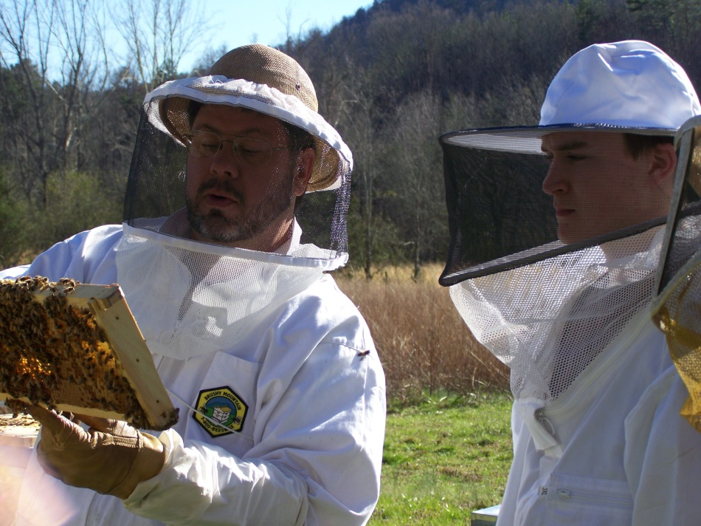
Seasonal Hive Management
Georgia
- Many temperate zones
- Up to 5 weeks difference
- Southern most to the Northern most areas
Today we will not discuss particular months
- Seasonal look
- Winter
- Spring
- Summer
- Fall

Slide 3
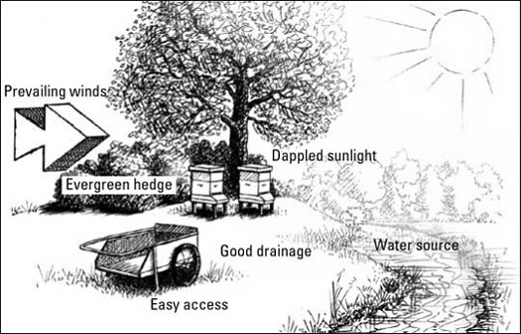
Placement of your hive
- Wind break
- Sun light on your hives
- Document what you are seeing and follow-up
- Good documentation will help you learn!
- Drainage (elevate the back of your hive by 1 degree)
o Water inside the hive
o Reduce moisture
- Water sources
- Ventilation
- Reduces mold
- Honey

Slide 4
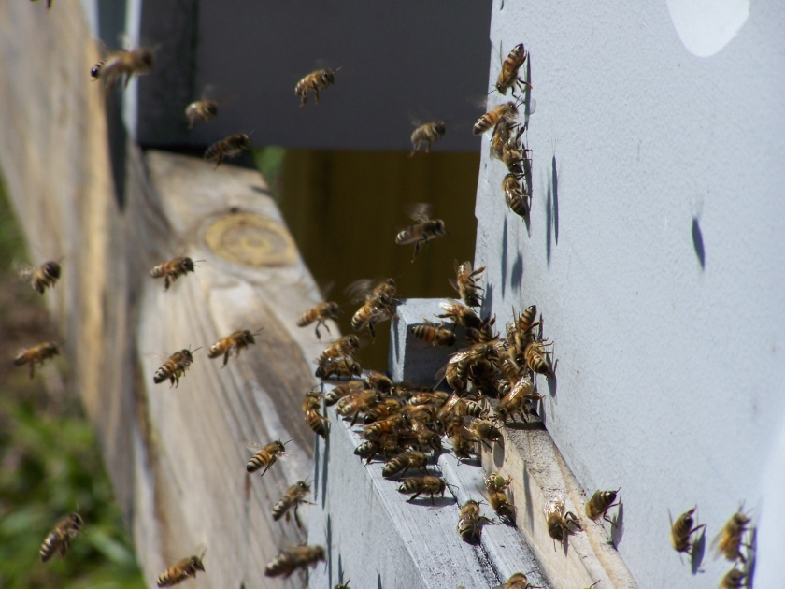
Early Spring – Action Items
Flora begin to bloom
More bees flying in and out of the hive!
Warm days of 55 degrees or higher
- Quick hive inspection
- Don’t want to chill the hive on cold days
Keep feeding sugar water and water
- When do you stop feeding?
- Nectar flow
- Slow usage
- Winter super is full

Slide 5
Early Spring – Action Items
Hive management is very important
- Identify weak hives for re-queening
- Why is this so hard to do?
- Pollen is coming in the hive
- May have to add a super due to bee space
- Helps reduce swarming
- Start building frames for supers
- Identify which hives do not need sugar water
- Winter honey super
Small hive beetles should be very minimal
- Keep on top of it!

Slide 6
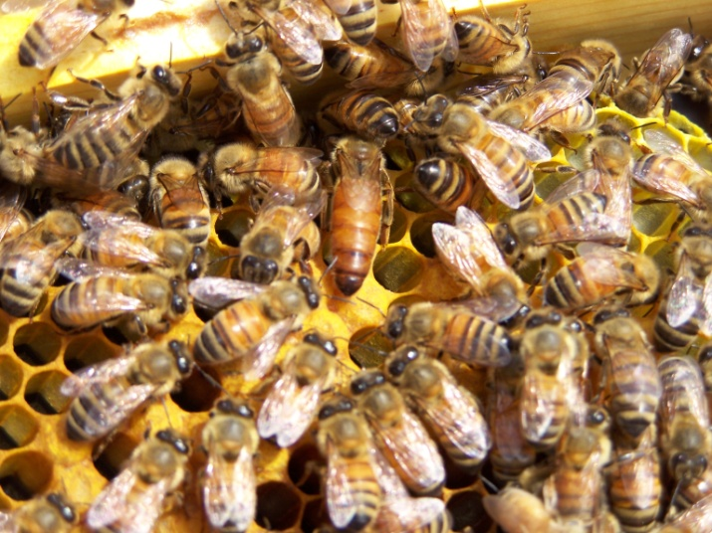
Spring season in your hive
Brood production should be going strong!
- Pollen is what keeps the queen laying.
- Queen is well mated
- Eggs
- Larva
- Capped brood
- Low brood production could mean your queen is failing
you must consider re-queening
- Possibly not properly mated

Slide 7
Spring season management of your hive
Brood production
Bee space – Keep your bee space adequate
- Too tight and you will promote swarming
- Too much space will allow competing
insects into the hive.
Rule of thumb
- 80% of frames are utilized (brood or honey)
- Full super of bees
- Signs - Inner cover has many bees between inner cover and top cover.

Slide 8
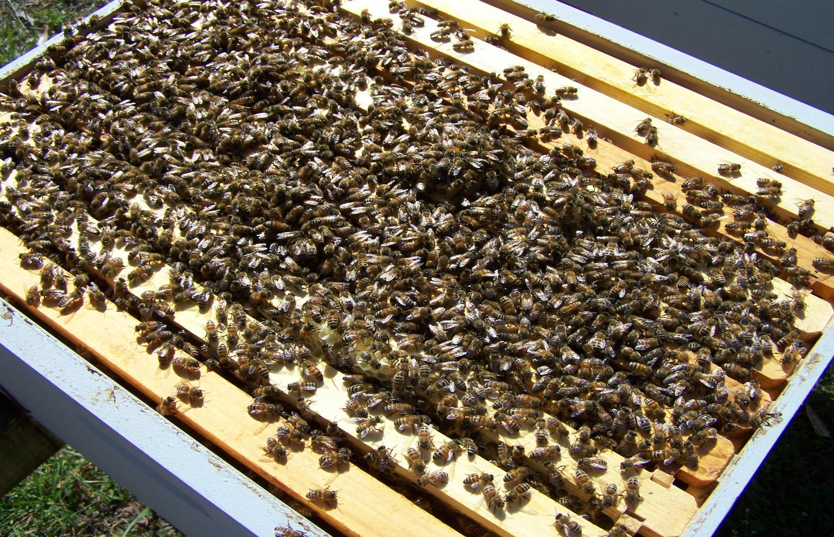
30% bee space in the hive

Slide 9
Late Spring – Action Items
Continue weekly hive inspections
Most important - watch “bee space” in hive
- Add supers as needed.
- Look for queen cells to eliminate swarming
- Swarming will cost you in the following ways:
I. Loss of honey production
II. Loss of bee population
- Watch for failing queens
- Last chance to add hives

Slide 10
Summer hive management
Successful Wintering begins in July?
- A good defense is a good offense!
- Strong hive population
Get into your hives weekly! (March to early October)
- Check brood production of the queen
- Queen Cells
- Small hive beetles ***
- Wax moths
- Standing water
- Bee population
- Hive condition
- Water source
- Weed control

Slide 11
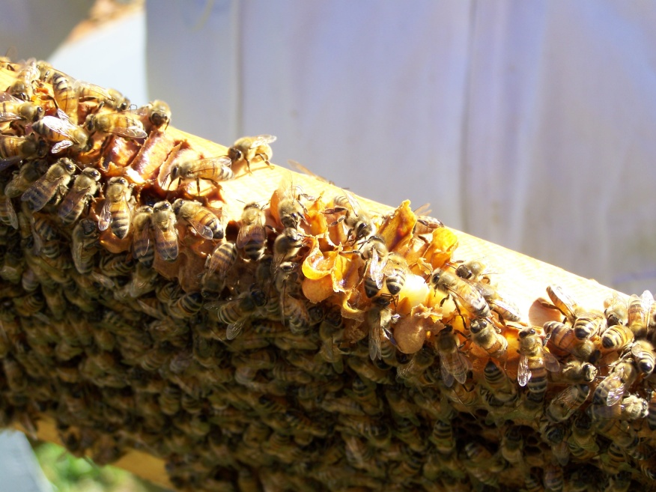
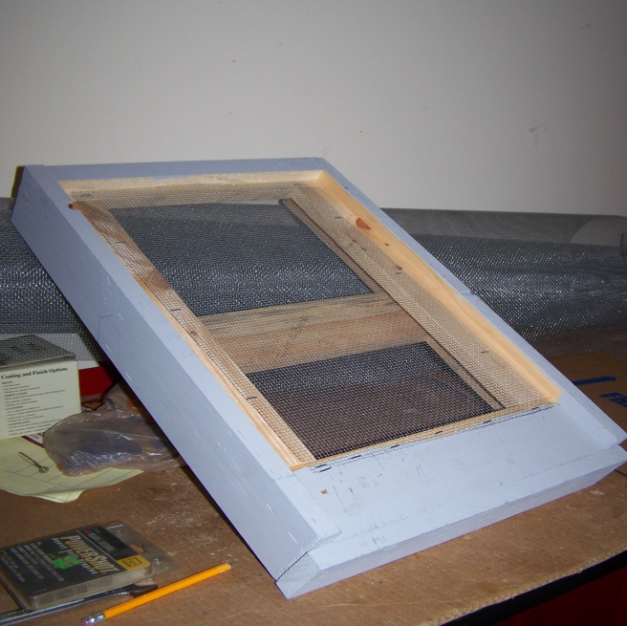
Summer – Action Items
Bees cool the hive by using water
- You will hear the bees use their wings to cool the hive
- Congregating on the outside of the hive – check bee-space
- Bees will go back into the hive an hour after sunset
Nectar flow decreases
Check for mites (mite treatment plan after nectar flow)
Screen bottom boards (Clean)

Slide 12
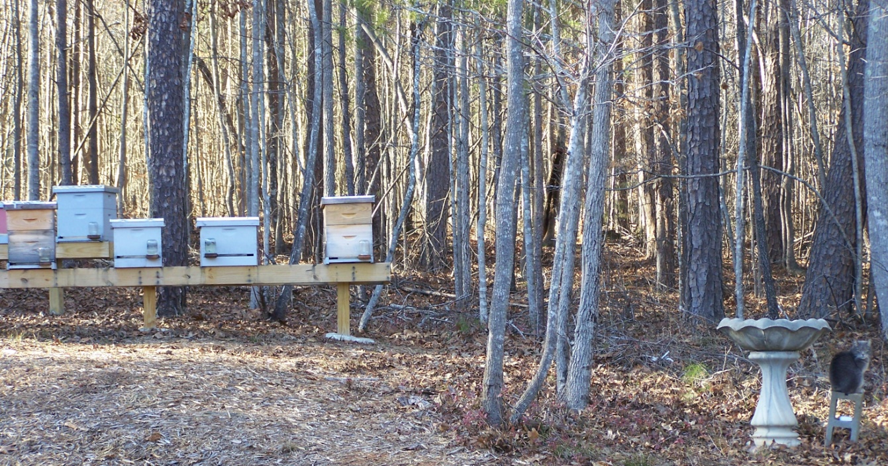
Fall season in your hive
Hive begins to transition over to winter bees.
Summer Bees will begin to be replaced
- Winter Bees begin to emerge
- Winter Bees are slightly bigger
Sugar water feeding
Repair hives

Slide 13
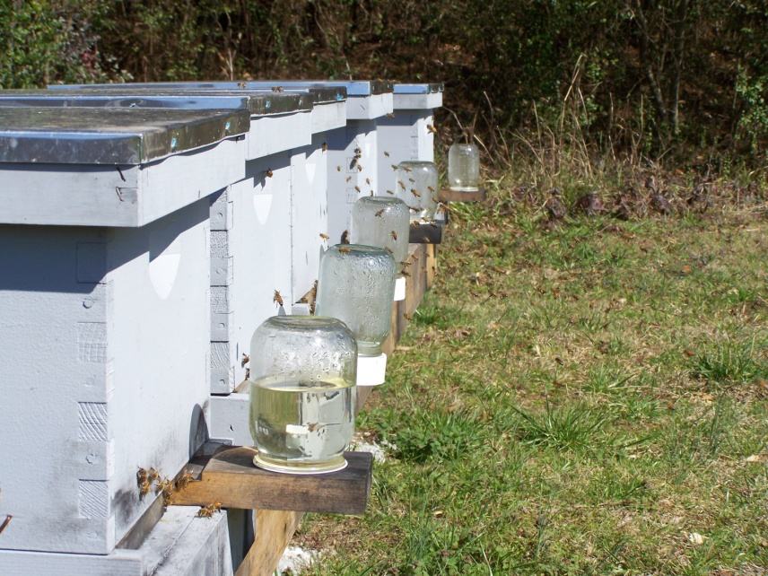
Late Fall Season – Action Items
Hives are now slowing down (Population, low exterior activity)
Smaller bee population (may have to take off a super)
Winter bees are now more common
Brood production is decreasing
Hive beetles are on the offensive
Golden Rod is the last pollen source
Sugar water feeding

Slide 14
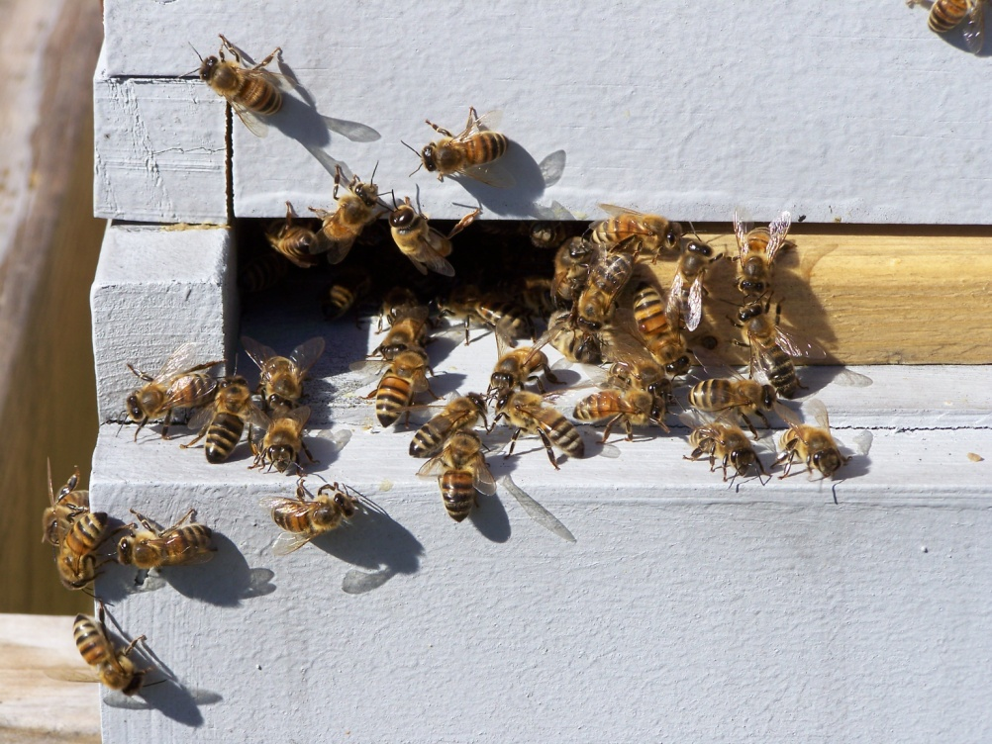
Late Fall into Winter – Action Items
Reduce hive opening down to 1 inch opening
Allows the hive to keep more heat
Begin monthly inspections on days above 55 degrees
Hive population
Hive condition
Brood condition
Softball size brood pattern
Weekly – Walk your bee yard
Hive activity
Sugar water usage

Slide 15
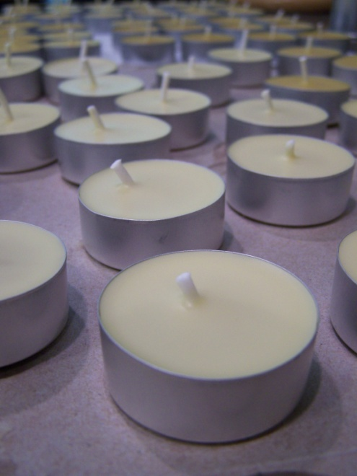
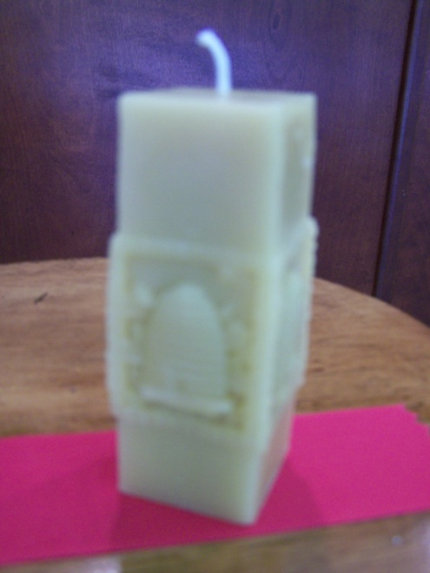
Winter – Action Items
Determine a game plan for your hobby for the spring
- Cut comb honey
New bee yard for better honey production
- Sourwood, Tupelo, etc..
What will you offer this year (Wax candles, honey jar sizes, etc)
Feed your bees!
Order your bees in
December for best
Ship and pickup dates.

Slide 16
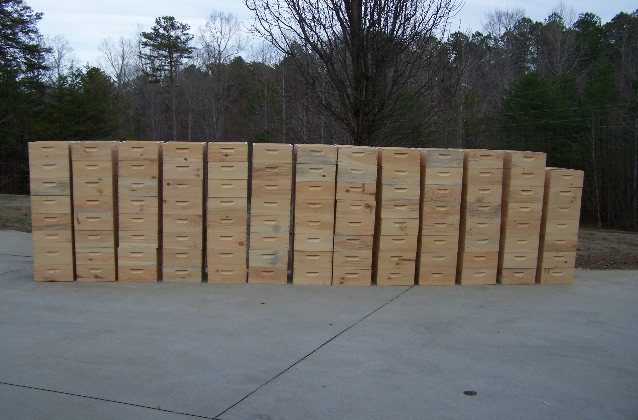
Winter – Action Items

Slide 17
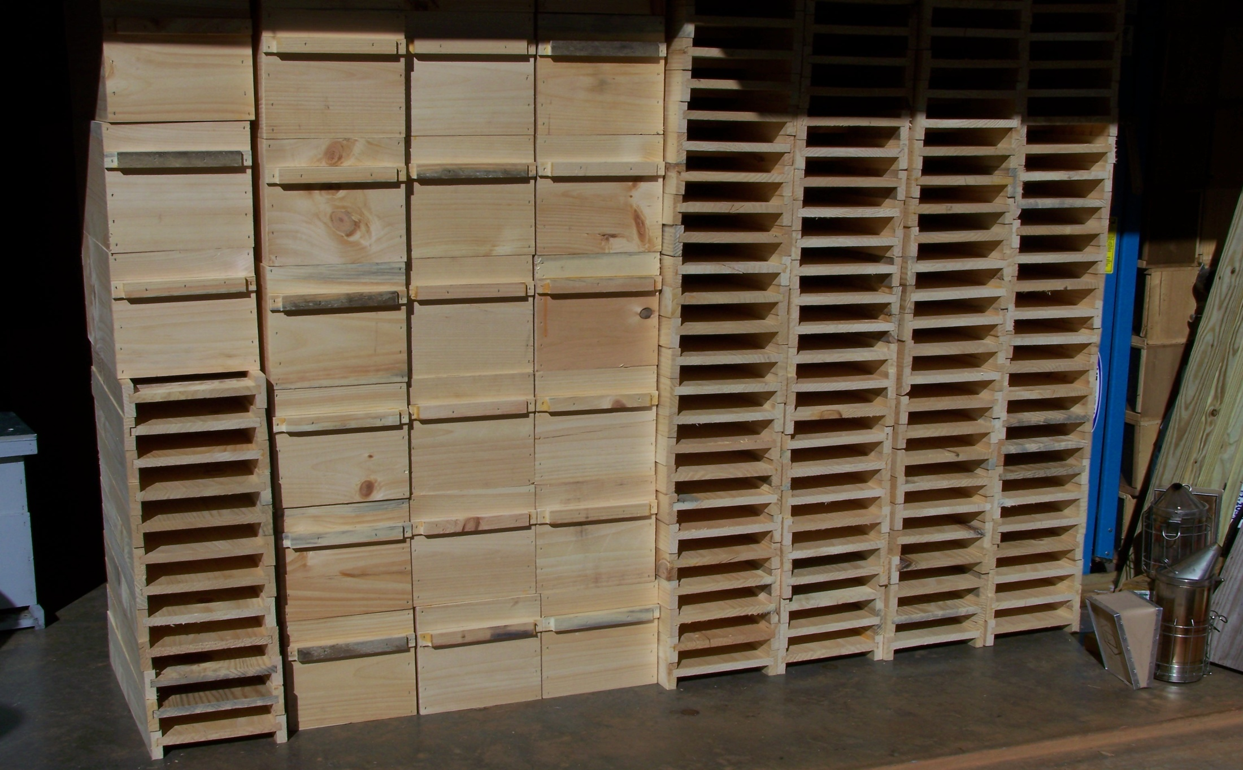
Winter – Action Items

Slide 18
Winter season in your hive
Make sure your bees can have honey during the winter!
- Leaving a medium super for your bees to consume
- Pull empty super
- Heat efficiency of the hive
- First year hives?
- Option is to feed sugar water for the winter
at a 2 to 1 ratio
- Limited honey for your first year to store up.
- If you take all the honey
- Be prepared to feed sugar water for the
next 8 months.
** Quick calculation is approx. 37 lbs. per hive for a first year hive.

Slide 19
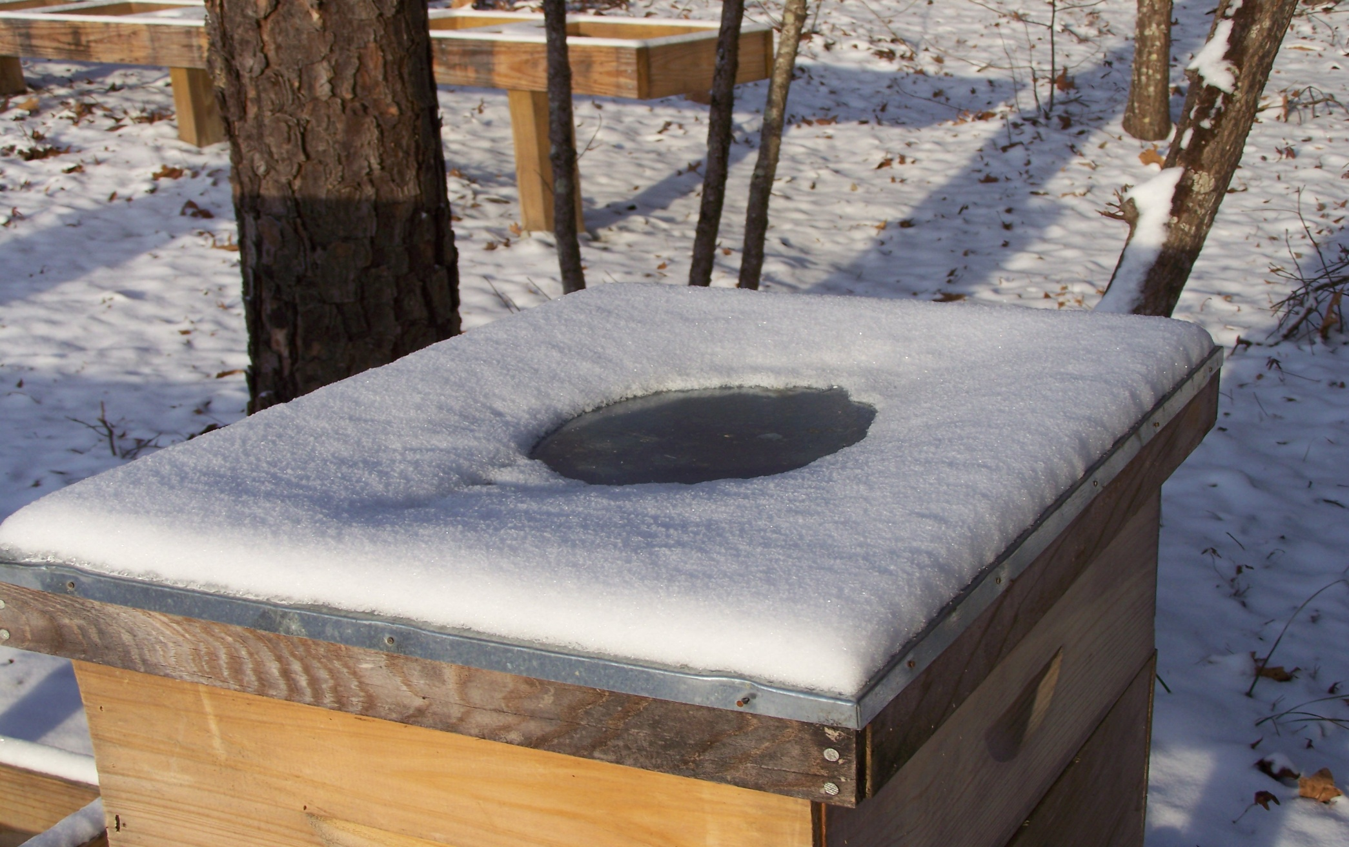
Winter season in your hive

Slide 20
Late Winter – Starvation
Large winter colony
- Large colonies eat through their winter honey stores
- Must monitor honey stores of the hive.
- Pickup the rear of the hive to feel the weight
- #1 reason for bee loss during the winter.
Late Winter Starvation
- Feed sugar water
- Pollen patties
- Take honey frames
from other hives.

Slide 21
Question & Answer Session
What questions do you have?
Visit our website at: MountainSweetHoney.com
Beekeeper News: Weekly Blog – Beginning Beekeeper to
Sideliners - Slides will be posted under this page.
“Like” us on Facebook: Mountain Sweet Honey Co.

